Slide 1
Publishing biodiversity data via GBIF data templates and IPT2
Hsiang-Ying Li, Jason Mai
Biodiversity Research Center, Academia Sinica
2012.06.25

Slide 2
Please connect to wireless network
SSID: meeting

Slide 3
Outline
Data publishing workflow
Darwin Core Archive
Spreadsheet template
Metadata
Occurrence record
Checklist
Publish your data
Publish DwC-A using the Integrated Publishing Toolkit

Slide 4

Data publishing workflow
Major steps leading to the discovery and accessibility of the biodiversity data
selecting appropriate data-publishing tools (or options) on the basis of data-type, technical skill sets, and available technical capacity
preparing dataset to conform with the standard data exchange format
publishing dataset employing the appropriate data publishing tool
registering the data access-point in the GBIF Registry
Notes:
First, we have to understand our data format, content, range.. Then select appropriate tool to publish it. Finally register it, and share it with GBIF.

Slide 5
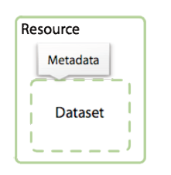
Know your data – scope
Biodiversity data published are organized into datasets or data resources
A dataset is a collection of data records
Datasets are described by metadata
A data record is a collection of record elements or properties
Notes:
A example data records may described from museum specimen, the scientific name is certainly contained as record element.

Slide 6
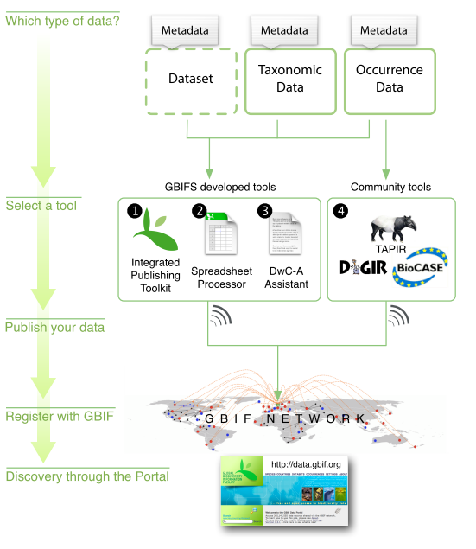
Know your data – three core types
Primary biodiversity data or occurrence data
An example dataset would be a collection of bird observation data records
Another example would be a collection of specimen data records from a natural history museum
Taxonomic data
Resource (or dataset)
Notes:
This category of information refers to data or information relating to a specific instance of a taxon, usually a species, in nature, in a collection or in a dataset.
Give two examples , this data type may be a collection of bird observation records or a collection of specimen data records from natural history museum.
2. This category of information refers to data or information relating to a taxon and not necessarily to a specific instance (occurrence) of an individual within that taxon.
For example, it could be an annotated checklist of bird species where a data record.
3.

Slide 7
Know your data – metadata
Metadata are data records that provide descriptive information about datasets
It is very important for data discovery and accessibility
Notes:
Data publishers can also publish metadata about datasets that are yet ready to be published.

Slide 8
An overview of data publishing options in the GBIF Network
Notes:
We have mentioned three data types,

Slide 9
About publishing taxonomic data
Darwin Core Archives are the only format that GBIF supports for publishing species data through GBIF
Taxonomic catalogues and monographic data
Species descriptions such as might appear on a website “species page”
Images and other multimedia
Distribution details
Measurements and Facts
And more…

Slide 10

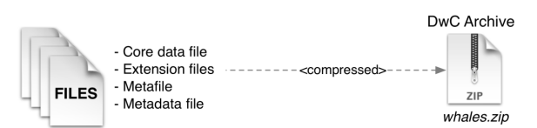

Darwin core archive
Definition: an informatics data standard that makes use of the Darwin Core terms to produce a single, self-contained dataset for checklist data.
The data which can be provided as a single compressed file is composed of a descriptive metadata document, and a set of one or more data files.
compressed

Slide 11
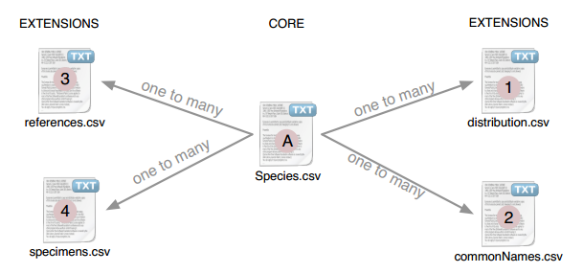
Darwin core archive
Advantage:
DwC-A allow much simpler and more efficient data transfer
Core file is surrounded by a number of flexible extensions
Notes:
The file are logically arranged in a star-like manner with one core file, containing the basic checklist elements (species list, classification,
synonymy) surrounded by a number of ‘extensions’, that describe related data types (such as common names).

Slide 12
The approaches to generate DwC-A
GBIF Darwin Core Spreadsheet Templates
Integrated Publishing Toolkit
Create your own Darwin Core Archive

Slide 13
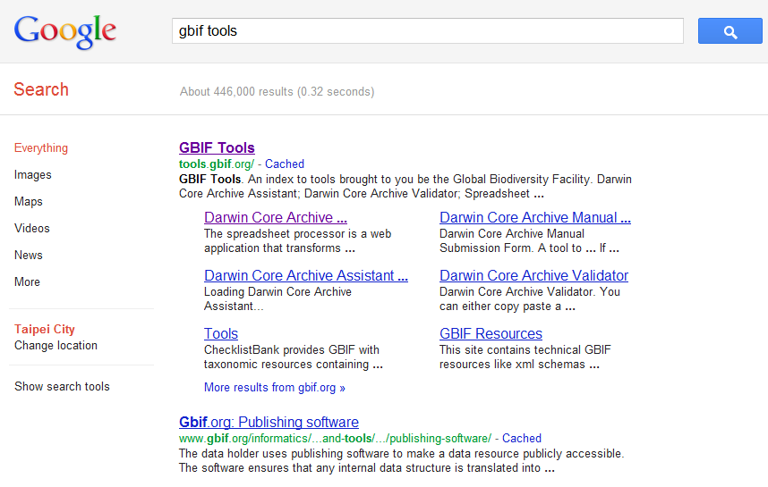
Where to find the spreadsheet templates
Search for: GBIF Tools

Slide 14
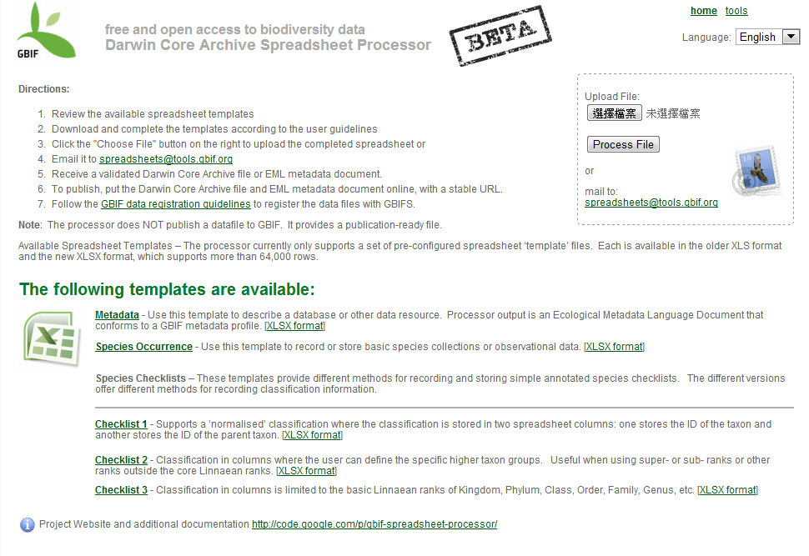
Spreadsheet template and processor
http://tools.gbif.org/spreadsheet-processor/
Download a templates according to your data type
Metadata
Occurrence
Checklist
Notes:
See the page below, we could download three different checklists, and then fulfill the metadata and your data. Upload your file, you could get the folder included the Dwc-A format text.

Slide 15
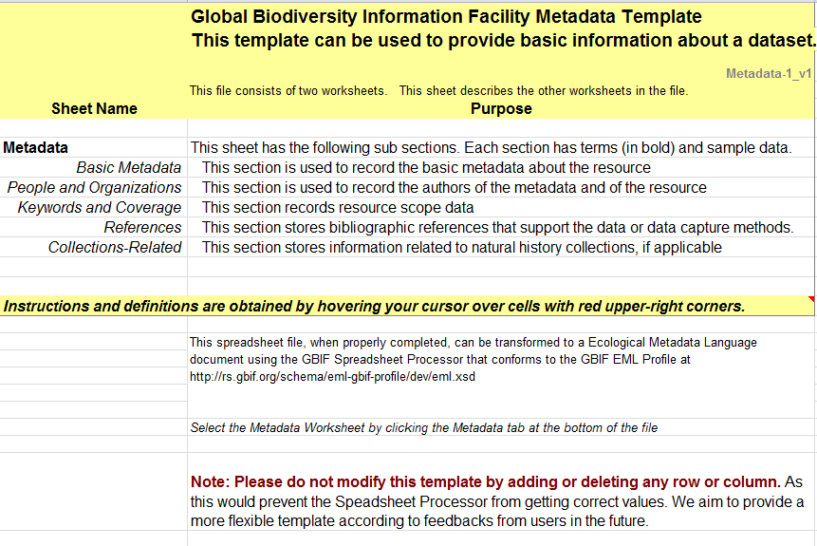
Metadata template
Two sheets are included (Readme, Metadata)
Readme
What kind of data should be filled in
For getting correct values, DO NOT modify it randomly!!

Slide 16
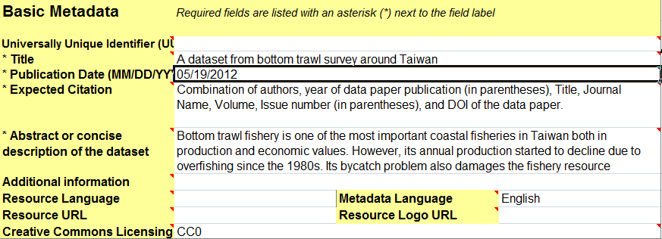

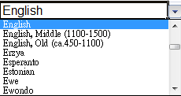
Metadata template - general User Interface
Metadata
Star sign (＊) means this field is required
Some fields providing the dropdown list can be chosen

Slide 17
Metadata template – contents
Basic Metadata
Title, abstract,…etc.
People and Organizations
Authors of metadata and of this resource
Keywords and Coverage
Scope data of this resource
References
Bibliographic references support the data
Collections-Related
Information related to natural history collections

Slide 18
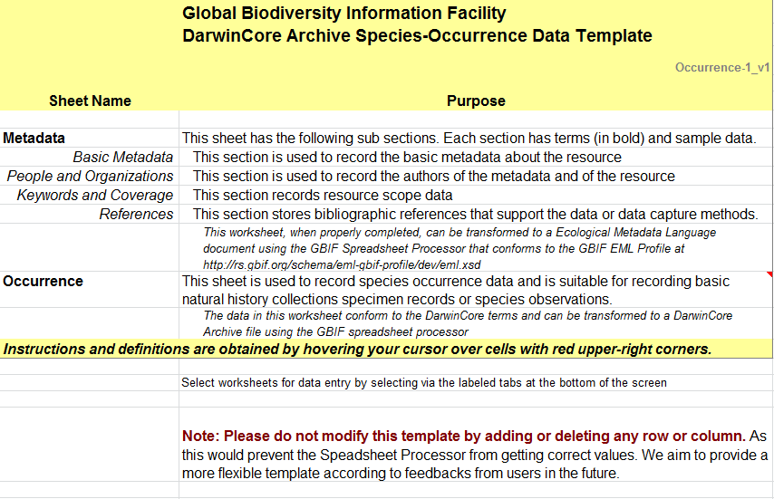
Species occurrence template
Three sheets are included (Readme, Metadata, Occurrence)

Slide 19
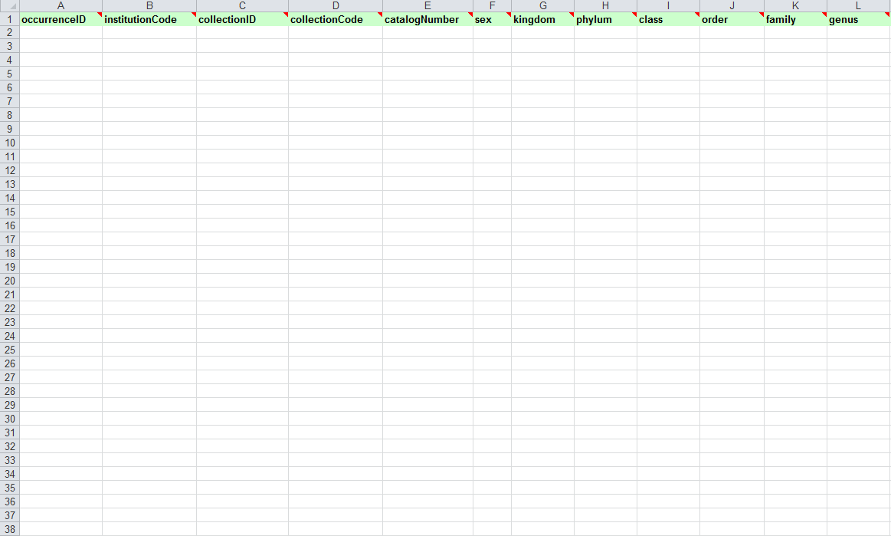
Species occurrence template (cont.)
Occurrence data
Identifier (institution code, collection code…)
Taxonomy (kingdom, phylum, class…)
Spatial Context (country, locality, elevation...)
Temporal Context (collection year, month...)
Person Involved

Slide 20
Checklist templates
Three sheets are included (Readme, Metadata, Classification).
The metadata sheet of the checklist template are the same as the metadata template except Collections-related section.
Three formats of classification sheet

Slide 21
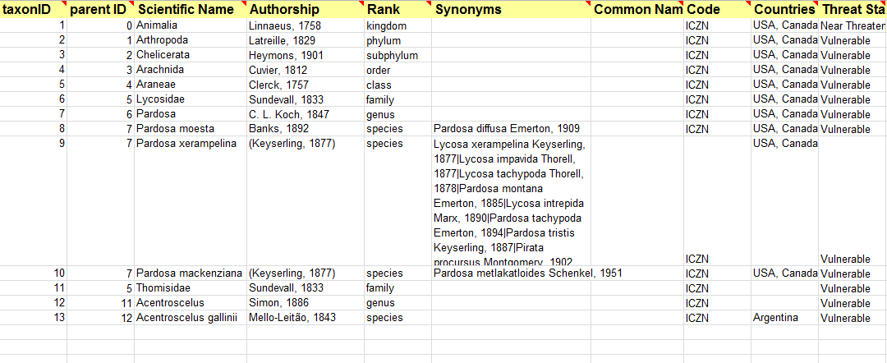
Checklist 1 – Parent/Child
Each taxon is represented by a single row.
Identifier
Taxonomy content
Using ”|” distinguish two or more synonyms
Notes:
Top-most member of a hierarchy has no parent identifier should be null or 0. In the example below, the parent of record 8 ,scientific name” Pardosa moesta”is record 7, the genus Pardosa.

Slide 22
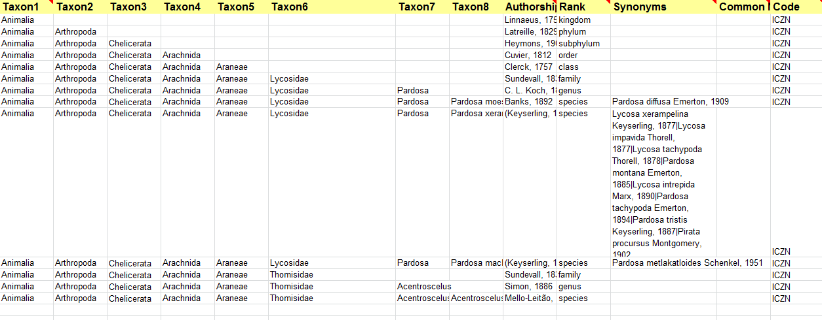
Checklist 2 – ladder-formed classification
This worksheet supports up to 8 hierarchical ranks.
Indicate the specific taxon rank
A taxon row must contain it’s parent columns
Notes:
This worksheet supports up to 8 hierarchical ranks. The synonym are distinguished as checklist1.

Slide 23
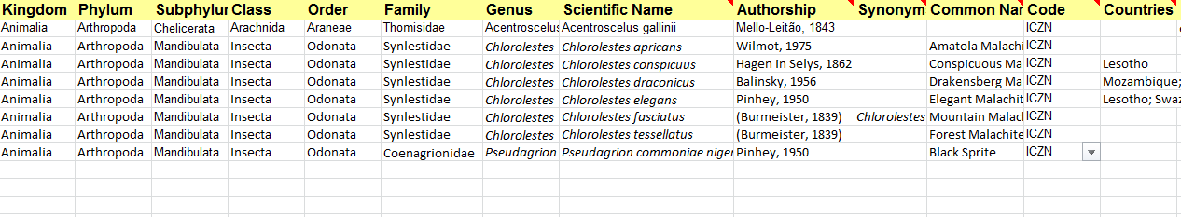
Checklist 3 – plain-formed classification
Each row of data table refers to one of the terminal taxa.
This format treats higher taxa as properties of a species, not as separate taxon records themselves.
A taxon row must contain its parent columns
Notes:
This format does not allow properties of higher taxa to be shared either in the core file or in any extensions.

Slide 24
Spreadsheet template and processor
Advantage
Easy to enter information in the Excel spreadsheet
The template can be edited using free, open-source software (e.g.OpenOffice)
Disadvantage
The content structure of these spreadsheets can not be modified, except for the entry of data

Slide 25
Publish your data
Take taxonomic data for example
Use checklist template 1

Slide 26
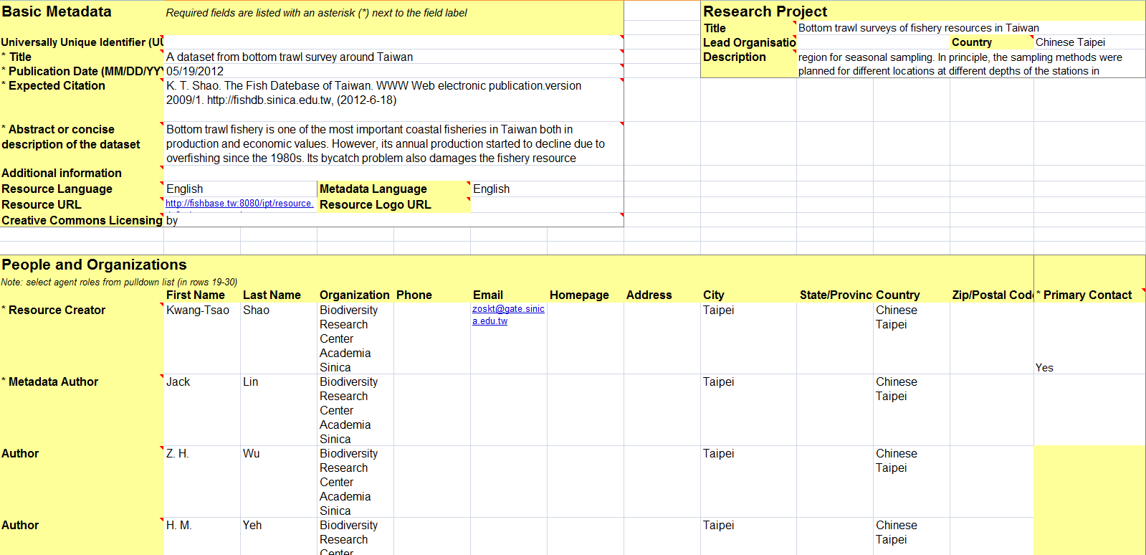
Example metadata
Example data is in the flash disk in your data bag.
In directory “Samples for Exercises”
File name “metadata_example.xls”

Slide 27
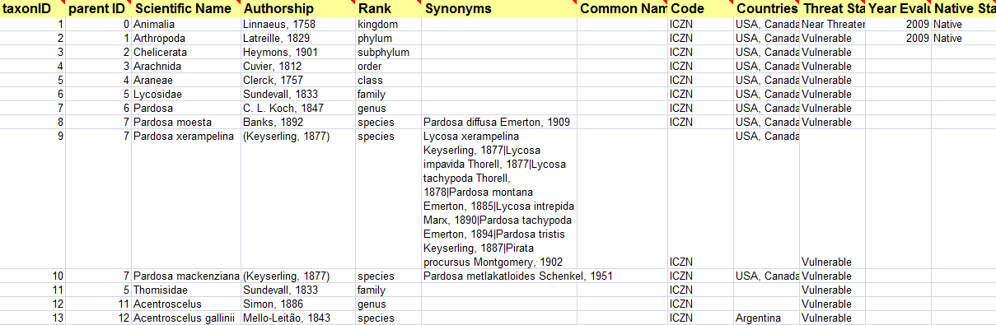
Example taxonomic data
Example data is in the flash disk in your data bag.
In directory “Samples for Exercises”
File name “metadata_example.xls”

Slide 28
Upload and process checklist template
1. Upload your data
2. Process File
Notes:
See the page below, we could download three different checklists, and then fulfill the metadata and your data. Upload your file, you could get the folder included the Dwc-A format text.

Slide 29
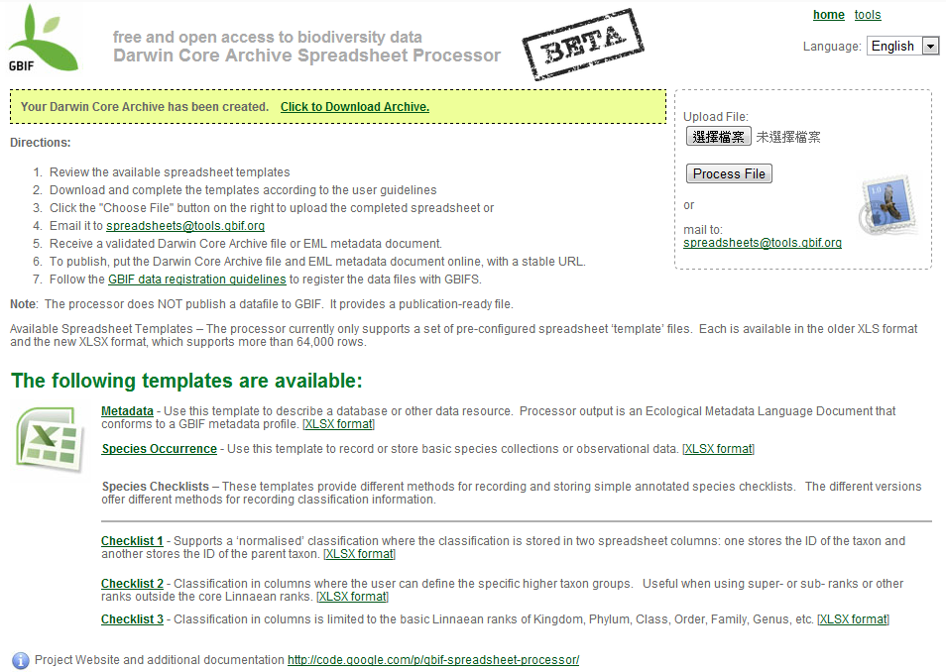
Download your DwC-A file
Confirm your data created successfully and download your DwC-A File

Slide 30
Publish the generated DwC-A
Two ways
Communicate with node managers
Publish by a living IPT server

Slide 31
Publish DwC-A using the Integrated Publishing Toolkit (IPT)
Prepare your Data
your data are already stored as a csv/tab text file
one of the supported relational database management systems
Import from a DwC-A file directly
Create a mapping between the source data and the Darwin Core terms, using the IPT interface to match your own column headers against the terms.
ensure that the appropriate core types and extensions are loaded
Publish the new DwC-Archive, using the IPT dialogue

Slide 32
Next segment
Publish data using IPT2 by importing DwC-A generated from GBIF spreadsheet processor

Slide 33
In this segment we will…
Create a new resource by importing a DwC-A file
Have a quick demonstration of user interface and data publishing workflow of IPT2
Take a DwC-A file containing checklist and distribution data generated by spreadsheet processor as an example

Slide 34
Connect to IPT2
Please connect to wireless network
SSID: IPT2AP1
Open your browser and link to http://192.168.1.2
Click “Sandbox” to connect to IPT2 server

Slide 35
Login IPT2
Your account is your email address used to register in this workshop.
Password is “1234”
If you cannot login with your email account, use public@example.org
Password is “1234”

Slide 36
Before we start…
The short name of a resource is used as a folder name (or directory name) in IPT’s data directory.
E.g. yourname@whatever.org
Every workshop participant must use a unique name (e.g. the username part of your email address), at least 3 characters in length.
If the short name already exists, just choose another one, please~

Slide 37
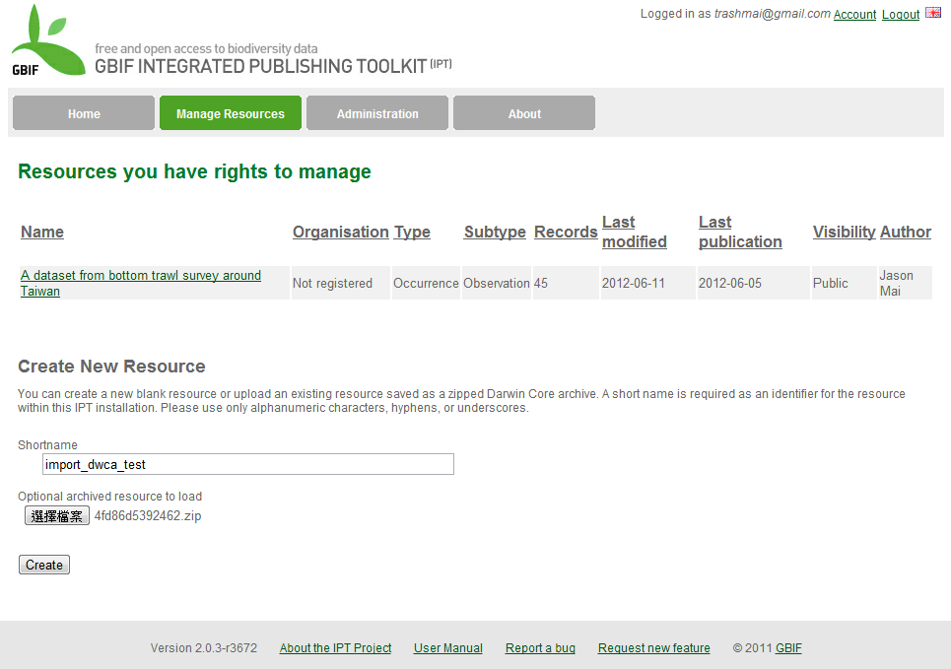
Create a resource by importing DwC-A
1. Click
2. Give your resource a short name (use 0-9,a-z,A-Z,hyphens,underscores); full title for the resource will be entered later
3. Import resource from the DwC-A you just created from spreadsheet processor
4. Click “Create” to continue

Slide 38
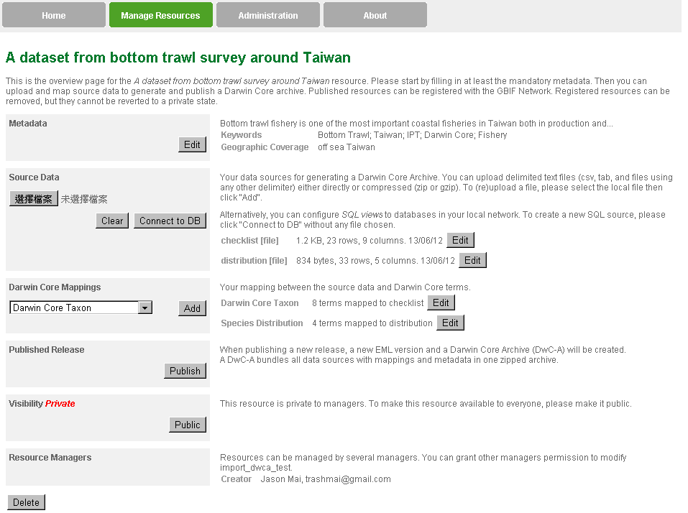
Overview of imported resource
Metadata
Source Data
Darwin Core Mappings
Publish
Go Public

Slide 39
Overview of imported resource
Create/modify metadata (in this case, we modify an existing file)

Slide 40
Sections of metadata
Basic Metadata
Geographic Coverage
Taxonomic Coverage
Temporal Coverage
Keywords
Associated Parties
Project Data
Sampling Methods
Citations
Collection Data
External Links
Additional Metadata

Slide 41
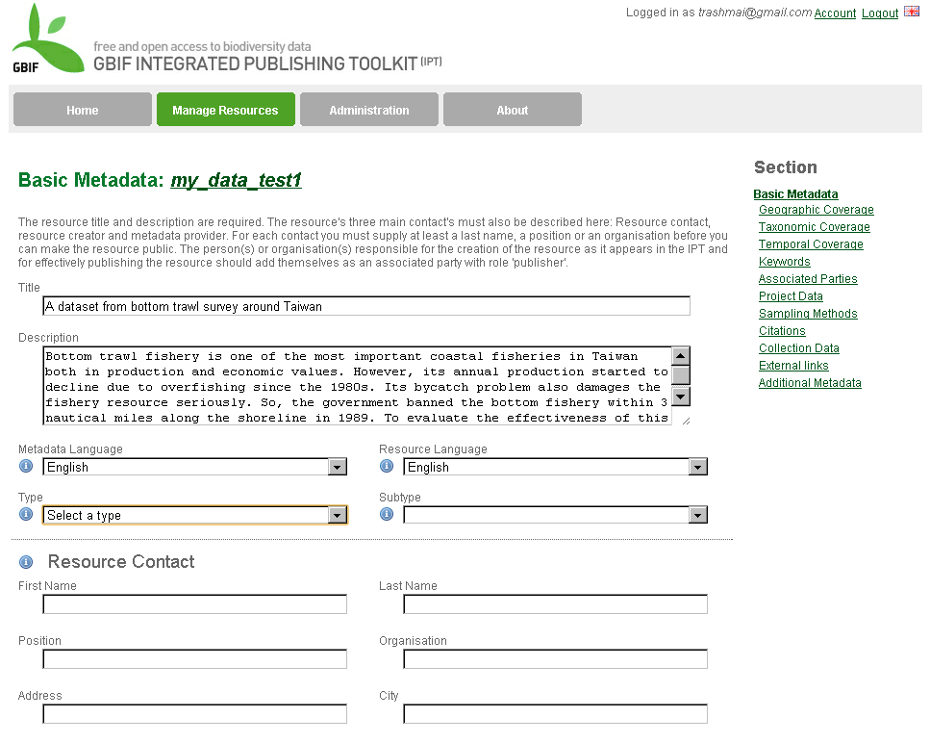
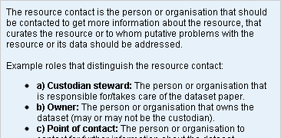
Tips
Don’t let this page idle too long; the system will log you out and you’ll have to re-login and re-do it all!
Click on the icon to read Help dialogue

Slide 42
Tips (cont.)
Click on any of them to switch pages; but before you do that, “Save” the current page first
Click on “Save” at the bottom of the page will automatically go to next page
Imported metadata/data

Slide 43
Basic metadata
Title (of your resource; will become the “Title” of your data paper)
Description (text describing the resource; will become the “Abstract” of your data paper)
Metadata Language and Resource Language
Type of the resource
Darwin Core Type : Taxon, Occurrence or other
One resource can only have one type

Slide 44
Basic metadata (cont.)
More about “Type”
Type decides the subset of DwC terms to be mapped into
“Subtype” is for human eyes only
Occurrence
Specimen
Observation
Checklist (Taxon)
Regional inventory
Thematic inventory
Taxonomic authority
Nomenclature authority
Derived from occurrence data

Slide 45
Basic metadata (cont.)
Resource Contact
The person or organization responsible for the resource and data paper
Resource Creator (content creator)
Metadata Provider (person or organization responsible for producing the resource metadata; probably YOU!)

Slide 46
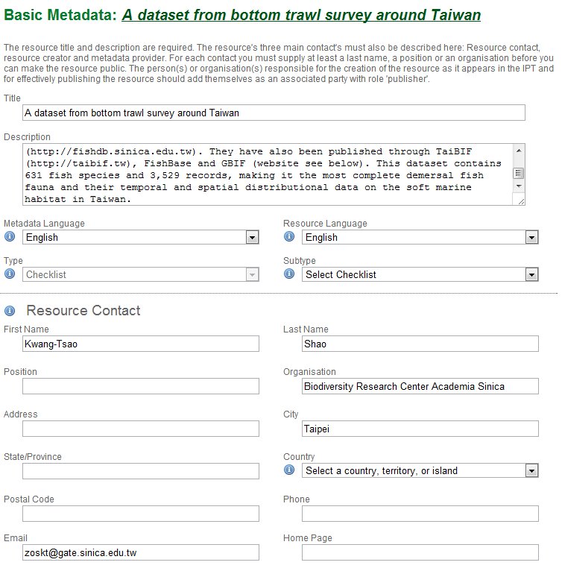
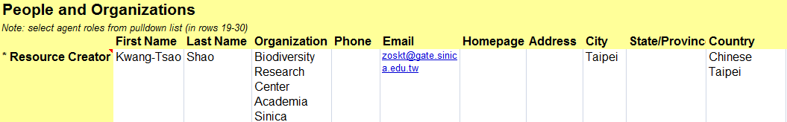
Basic metadata (cont.)
You may need to select a country for related persons again because country names will not be imported from the template.

Slide 47
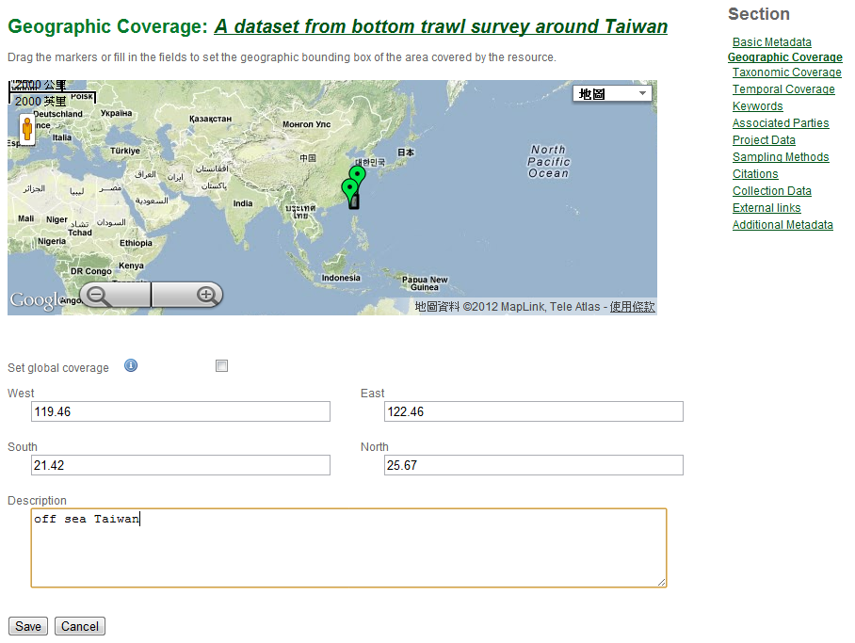
Geographic coverage
Geographic coverage metadata are shown on the map and in coordinates

Slide 48
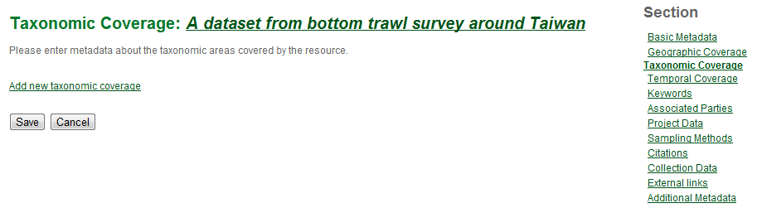
Taxonomic coverage
The taxonomic group (usually higher ranks) covered by the resource (i.e. included in your dataset)
Taxonomic coverage metadata will not be imported so you have to describe it again here

Slide 49
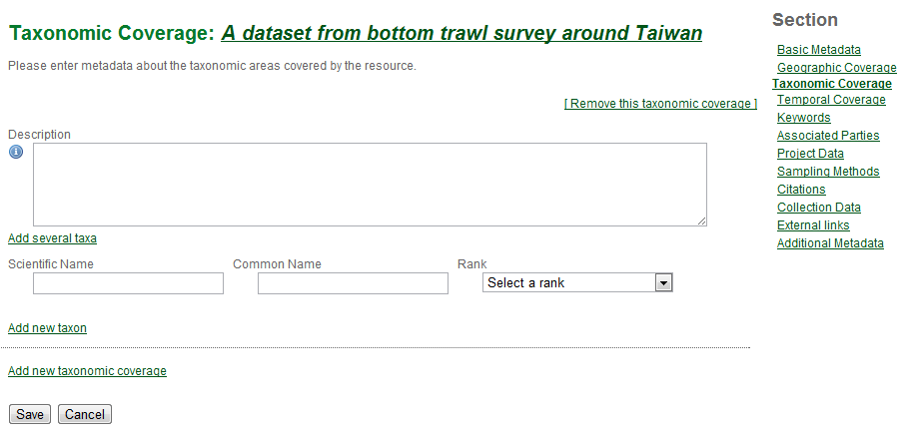
Taxonomic coverage (cont.)
Click to add a list of taxa, one taxon per line

Slide 50
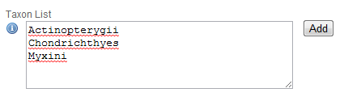
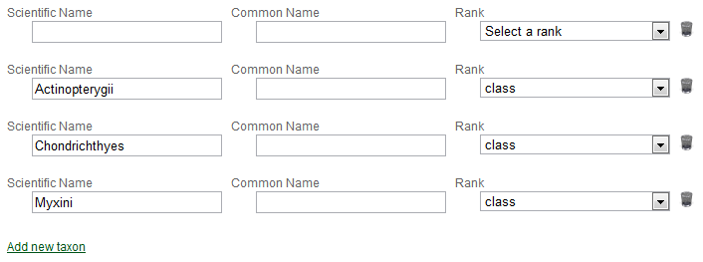
Taxonomic coverage (cont.)
1. Click “Add” when you’re done
2. Then IPT filled them in for you. You can delete one by clicking on the “Trash Icon”

Slide 51
Temporal coverage – 4 types
Single Date
YYYY-MM-DD or MM/DD/YYYY
Living Time Period
Time period during which the biological material were alive, including palaeontological time periods or other text phrases.
Formation Period
Text description of the time period during which the collection was assembled (e.g., “Victorian”, “1922-1932”, “c. 1750”).
Date Range
With Start Date and End Date

Slide 52
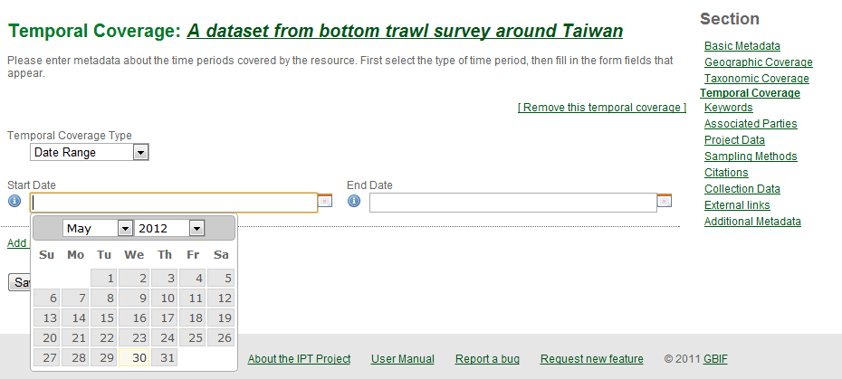
Temporal coverage (cont.)
2003-11-20
Enter a date in text field or select a date from the calendar.

Slide 53
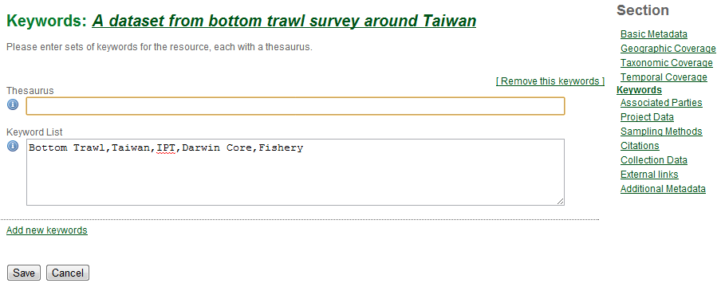
Keywords
If your keywords are derived from a thesaurus, enter the thesaurus name here; otherwise, enter “n/a”
n/a

Slide 54
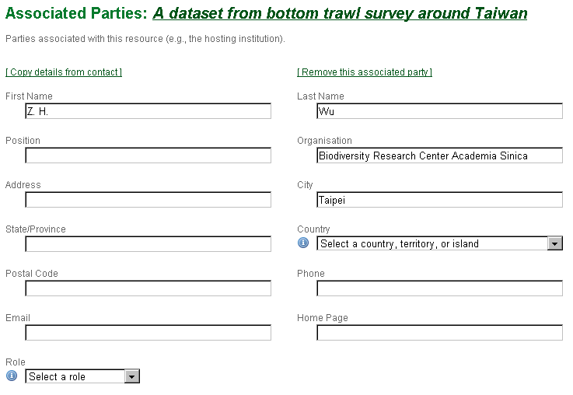
Associated parties
People or organizations associated with the resource, other than resource contact, creator or metadata provider, are entered here.

Slide 55
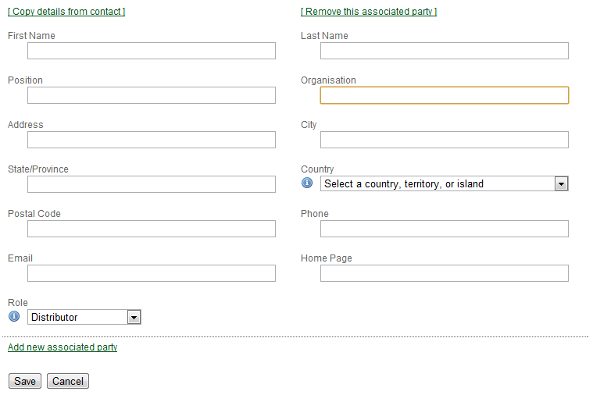
Associated parties (cont.)
The “Lead Organization” of “Research Project” in the DwC spreadsheet template will be shown as “Organisation” here with “Distributor” as the “Role.”

Slide 56
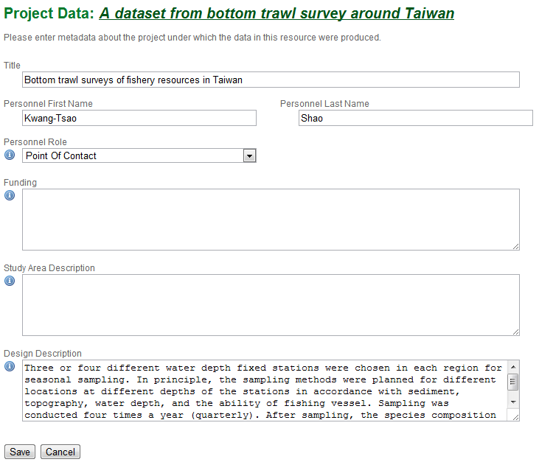
Project data
The “Description” of “Research Project” in DwC spreadsheet template is shown as “Design Description” here.

Slide 57
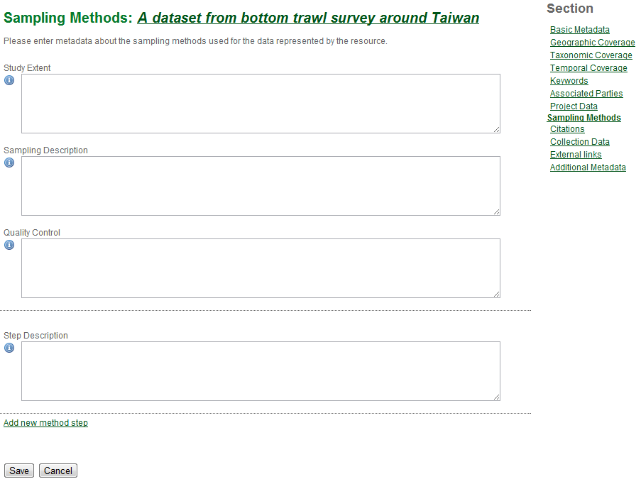
Sampling methods
Temporal, spatial and physical conditions
(not just extent, frequency can also be entered)
Description of sampling procedures found in the “Method” section of journal articles
This section is not included in the DwC spreadsheet template.
The actions you take to control or assess the quality of your data
How the data were acquired and processed so that other people can understand suitability of the data or reproduce your result
You can add a new step or remove a existed step

Slide 58
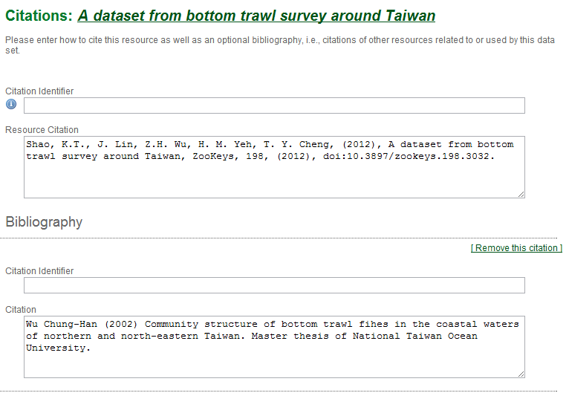
Citations
URL or DOI of your resource,
e.g. http://fishbase.tw:8080/ipt/resource.do?r=bottom_trawl_survey
Textual citation for the resource so people can cite it
e.g. K. T. Shao. The Fish Datebase of Taiwan. WWW Web electronic publication.version 2009/1. http://fishdb.sinica.edu.tw, (2012-6-18)
Additional citations used to produce the resource or as a result of the production of the resource

Slide 59
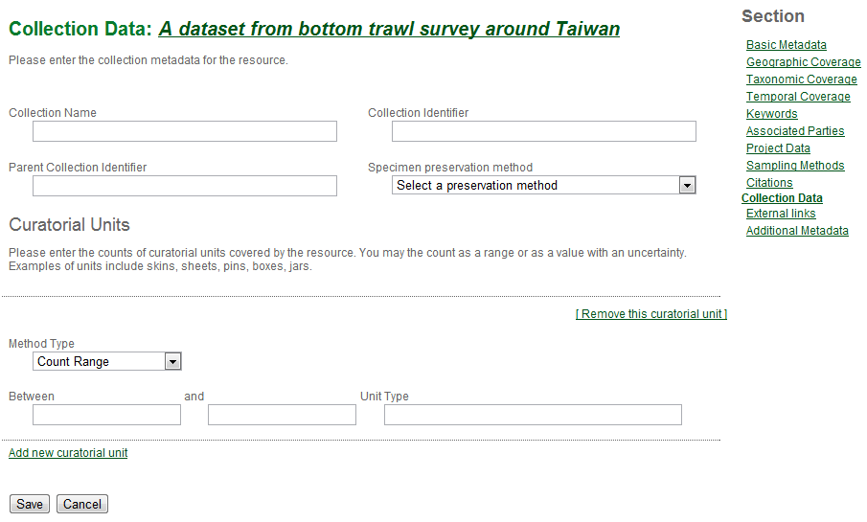
Collection data
Metadata about the physical natural history collection associated with the resource (if any); (not included in checklist templates)

Slide 60
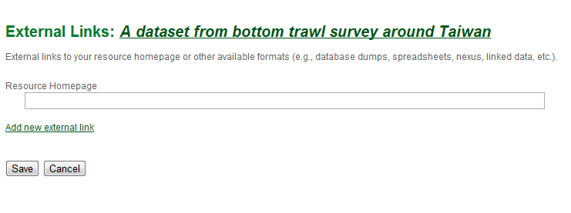
External links
The web page or link of the resource or dataset

Slide 61
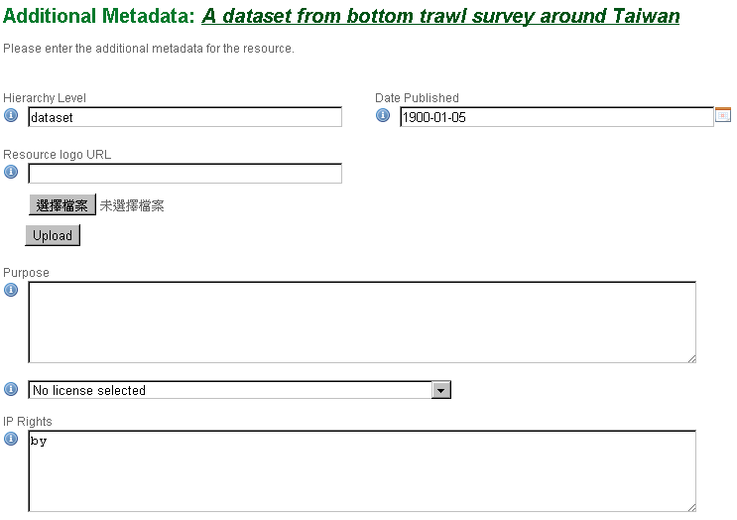
Additional metadata
The publishing date could be imported wrong, remember to fix it!
Any other related metadata are entered here, such as the purpose and IP rights of this resource/dataset.

Slide 62
Source data
Source Data

Slide 63
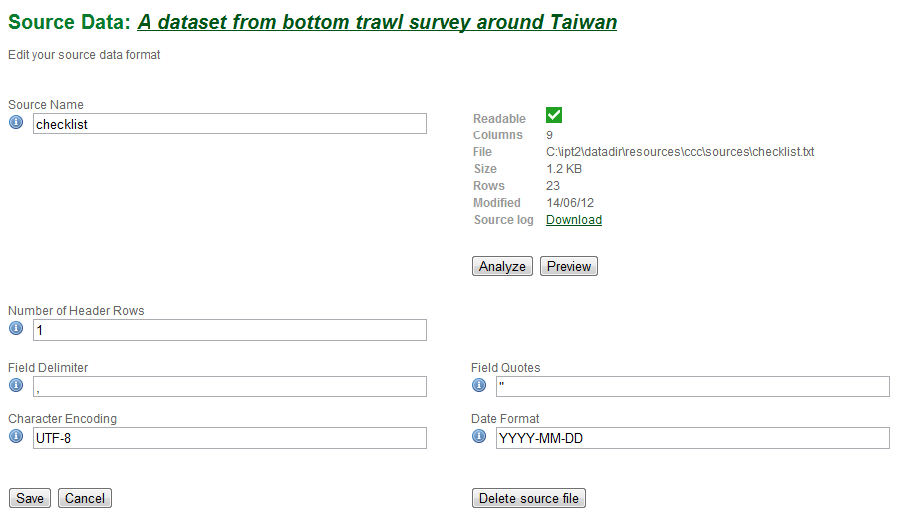
Source data imported from DwC-A
IPT can check the format for you
Click on "preview" to view content of source data

Slide 64
Overview of source data format
Source Name
Auto-generated name (usually the base name of the source data file), leave it alone
Number of Header Rows
The part of your file that is not part of your data (e.g. column names, column descriptions, etc.)
Field Delimiter
Choose from Tab (\t), Comma (,), Semicolon(;) or Pipe (|) according to your data file
Field Quotes
Choose from None, Double Quote(“) or Single Quote(‘)
Date Format

Slide 65
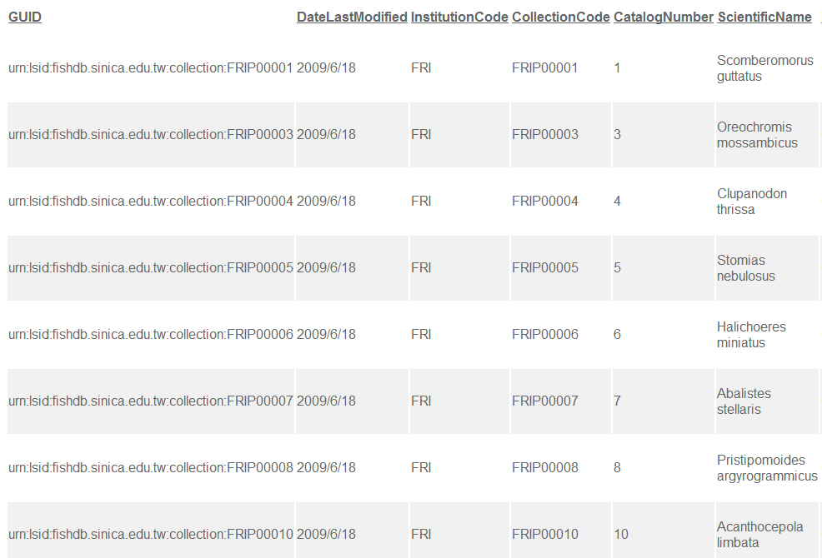
Preview of your source data
Header
Raw data
Click anywhere to leave the preview screen

Slide 66
Mappings
Mappings

Slide 67
Darwin Core categories
Record Level
Dublin Core
Darwin Core
Class
Occurrence
Event
Location
Geological Context
Identification
Taxon

Slide 68
Darwin Core categories (cont.)
Record Level
Terms applied to the whole record regardless of the record type
Examples
"Type" or "Basis of Record" means the nature or genre of the resource (e.g. collection, dataset, still image, machine observation, etc.)
"Rights" are the statements about property rights associated with the resource

Slide 69
Darwin Core Categories (cont.)
Class Occurrence
The category of information pertaining to evidence of occurrence in nature, in a collection, or in a dataset (specimen, observation, etc.)
Examples
"Recorded by" means the people, group or organization who is responsible for recording the original occurrence
"Individual count" means the number of individuals recorded in an occurrence

Slide 70
Darwin Core Categories (cont.)
Class Event
Information pertaining to an event
Examples
"Sampling protocol" means the name, reference, or description of sampling method/protocol used during an event
"Event Date" means the date-time or interval during which the event occurred

Slide 71
Darwin Core Categories (cont.)
Class Location
Spatial area or named place
Examples
"Country" means the name of the country or major administrative unit to which the location belongs
"Decimal Latitude" means the geographical latitude in decimal degrees of the geographical center of a location

Slide 72
Darwin Core Categories (cont.)
Class Geological Context
The geological context of the location
Example
"Earliest era or lowest erathem" means the full name of the earliest possible geochronologic era or lowest chronostratigraphic erathem attributable to the stratigraphic horizon from which the cataloged item was collected.

Slide 73
Darwin Core Categories (cont.)
Class Identification
Information pertaining to taxonomic determinations (the assignment of a scientific name)
Examples
"Identified by" means the people, group or organization who assigned the taxon to the subject
"Type status" means the nomenclatural types applied to the subject

Slide 74
Darwin Core categories (cont.)
Class Taxon
Information pertaining to taxonomic names, taxon name usages, or taxon concepts
Examples
"Scientific name" means the full scientific name, with authorship and date information if known
"Taxon rank" means the taxonomic rank of the most specific name in the scientific name

Slide 75
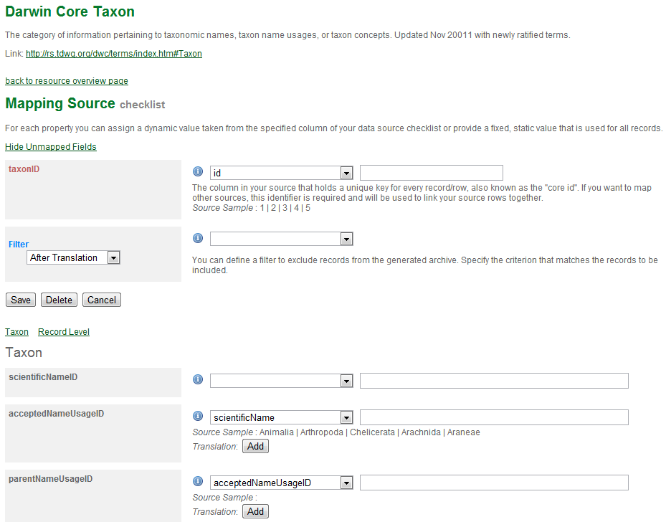
General info on data mappings
Click to read term descriptions and examples here
Define filters to exclude data not matching the criteria
Click to go back & forth between sections

Slide 76
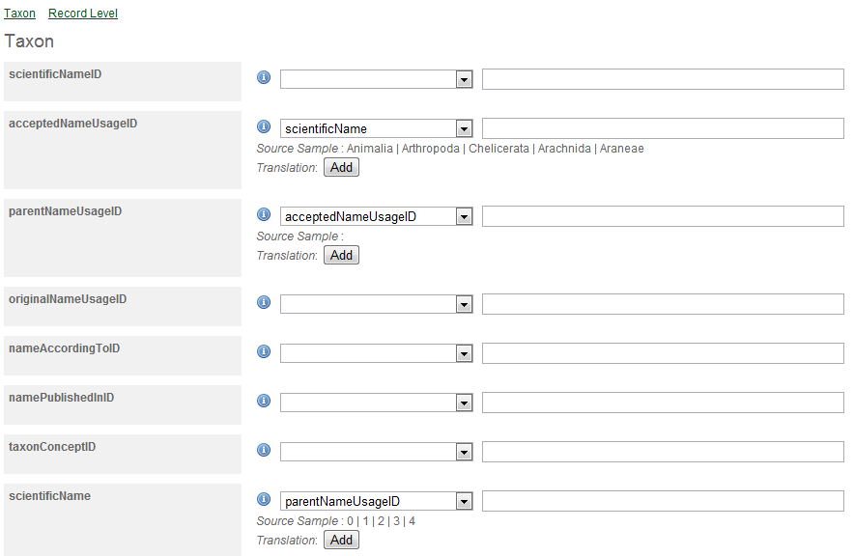
General info on data mapping (cont.)
Class name
Darwin Core terms to be mapping to
Columns of your data to be mapped

Slide 77
Special situations in creating "Checklist"
A species with more than one vernacular names, distributions or other attributes
Solutions
Save basic taxonomic info, vernacular names and distributions into separate files, upload the files and map their columns separately
Make sure taxon IDs of the two files match

Slide 78
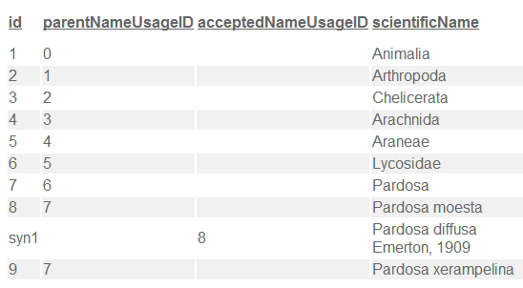
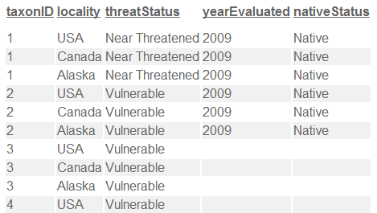
Example 1 – imported from DwC-A
After being processed, the data in checklist templates are split into two files, checklist.txt and distribution.txt, and are mapped to ‘checklist’ and ‘species distribution’ type.
dwc:taxonID
dwc:scientificName
dwc:taxonID
dwc:locality
distribution.txt
checklist.txt

Slide 79



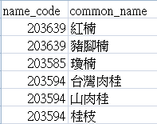
Example 2 – create by yourself
Select a suitable mapping type according to the subject of the source data file
dwc:taxonID
dwc:scientificName
dwc:taxonID
dwc:vernacularName
Source 1: scientific_names.txt
Source 2: vernacular_names.txt

Slide 80
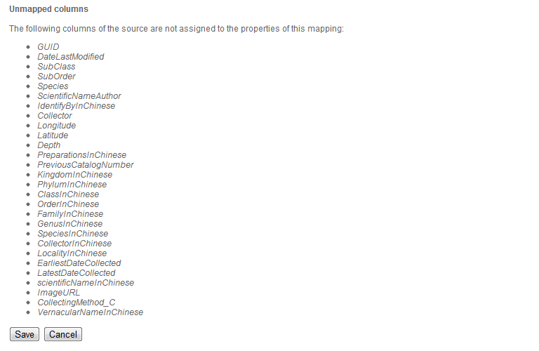
Unmapped columns show at the bottom
Check if you missed mappable columns
Nothing will be shown here if all the columns are mapped (e.g. source data generated from spreadsheet processor).

Slide 81
Publish resource
Publish your resource

Slide 82
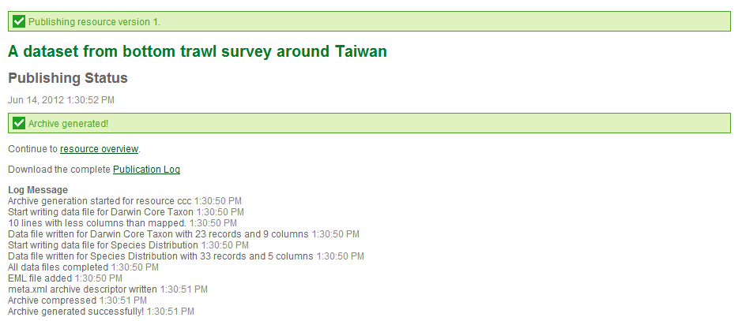
Publish resource (cont.)
This action generates a brand new DwC-A file containing:
An RTF file (draft of data paper)
An eml.xml file describing the metadata of this resource
An meta.xml file describing the mappings of DwC terms and source data columns
Source data files

Slide 83
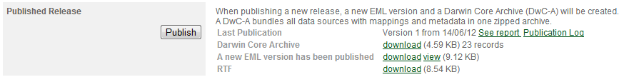
Publish resource (cont.)
Go back to the overview page of your resource and you can download the resource-related files here.

Slide 84
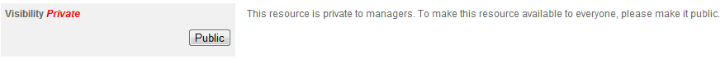
Make resource public
Click to make your resource public (i.e. available to everyone)

Slide 85
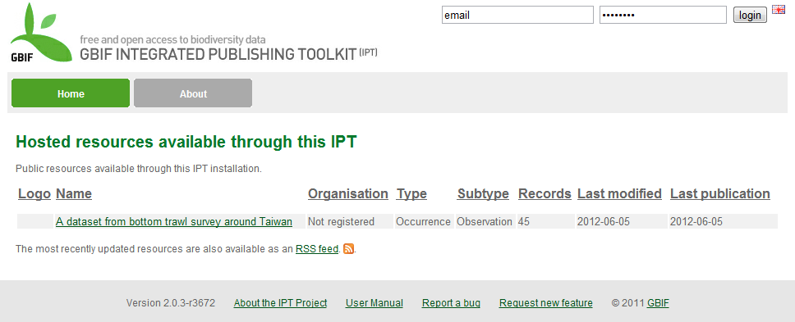
After make public
Even not logged in…
Everyone can see your metadata and data, and can subscribe RSS feed

Slide 86
Thank You!
http://taibif.tw

